Slide 1
Introduction to Python
Thaddeus Aid
Department of Statistics
And
IT Learning Program
University of Oxford

Slide 2
Lists
We have briefly touched on Lists before
The simplest way of making a List
x = [“Hi”, “I'm”, “a”, “list”]
y = [1, 2, 3, 4, “This is also a list”]
z = [3, 5.5, [5, 6]]
Indexing is the same as Strings – y[3]
Length is also the same as Strings – len(x)

Slide 3
List Functions
In:
fruit = [“apple”, “pear”, “banana”]
print (“pear” in fruit) # true
Concatenation works similar to Strings:
stuff = fruit + [“kiwi”, “cherries”]
Repetition also works similar to Strings:
stuff = fruit + [“kiwi”] * 2
Slices:
fruit[1:2] # pear, banana

Slide 4
List Mutability
Unlike Strings, Lists are mutable
name = “Thaddeus”
name[1] = “H” # Error
names = [“Thaddeus”, “Scarlet”, “Samantha”]
names[2] = “Emily” # replaces Samantha
Deletion:
del names[2] # removes Emily

Slide 5
Objects and References
An object is an idea turned into code
A reference is a handle that points to an object
a = “banana”
The reference is a and the object is a String
To save memory space identical strings will have more than one reference pointed at them
b = “banana”
a is b # true

Slide 6
Objects and References 2
Lists are mutable, so Python has to create different objects to hold data.
A = [1, 2, 3]
B = [1, 2, 3]
A is B # False
A == B # True
We can alias an object
B = A
A is B # True

Slide 7
Lists Cloning
We can clone a list to make separate changes
a = [1, 2, 3]
b = a[:] # b now has a copy of the list
a is b # False
a == b # True

Slide 8
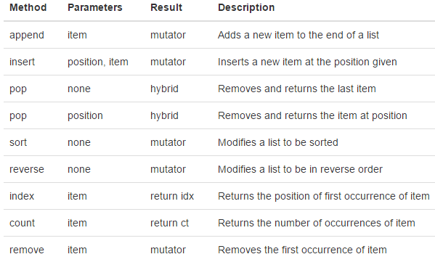
List Methods

Slide 9
Lists and for loops
Lists can use for loops in two ways
fruits = [“apple”, “pear”, “banana”]
for fruit in fruits:
  print(fruit)
for x in range(len(fruits)):
  print(fruits[x])

Slide 10
Lists as Parameters
When passing a list to a function the list is passed by reference so that any changes made to the list in the function will change the real list.
def changeList(aList):
  aList[0] = 0
ourList = [1, 2, 3]
chageList(ourList)
print(ourList[0]) # 0

Slide 11
Pure Functions
Previously we changed the List passed as a parameter, this is called a side effect, to avoid that we can change the function as follows.
def change(aList):
  newList = aList[:]
  newList[0] = 0
  return newList
things = [1, 2, 3]
newThings = change(things)
print(newThings[0]) # 0
Pure functions tend to be less error prone in general.

Slide 12
Functions that Produce Lists
You can produce a List inside of a Function and return it.
def makeList():
  aList = []
  for i in range(20):
    aList.append(i * 2)
  return aList

Slide 13
Strings and Lists
Often you will need to cut a string into components.
name = “Thaddeus Aid”
nameList = name.split() # nameList = [“Thaddeus”, “Aid”]
nameList = name.split(“dd”) # [“Tha”, “eus Aid”]

Slide 14
Stings and Lists
Some times you need to translate a List into a String.
aList = [“Hello”, “World”]
glue = “ “
helloWorld = glue.join(aList) # “Hello World”

Slide 15
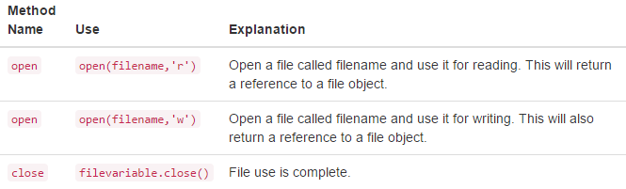
Files
dataFile = open(“someData.txt”, “r”)
outFile = open(“results.txt”, “w”)
dataFile.close()
outFile.close()

Slide 16
For with Files
To iterate over each line of a file
inFile = open(“data.txt”, “r”)
for line in inFile:
# Do something
inFile.close()

Slide 17
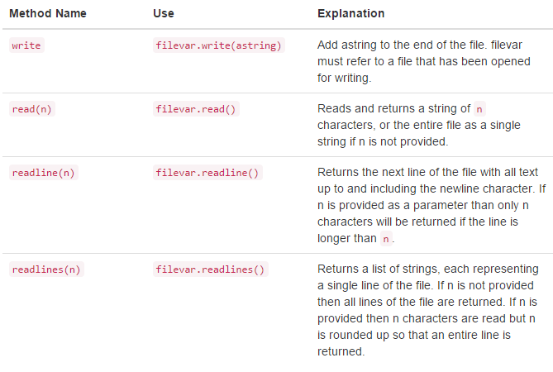
File Methods

Slide 18
Writing Files
In order to write into a file use the following syntax.
outFile = open(“results.txt”, “w”)
outFile.write(“Thaddeus Aid\n”)
outFile.close()
outFile = open(“results.txt”, “w”)
for x in dataList:
OutFile.write(x + “\n”)
outFile.close()

Slide 19
Assignment
This week please read the chapters for Lists and Files.
Oxford Students – Please implement a binary search algorithm. Details to follow in email.
Please like, share, and subscribe to this channel!

